Slide 1
Stack

Slide 2
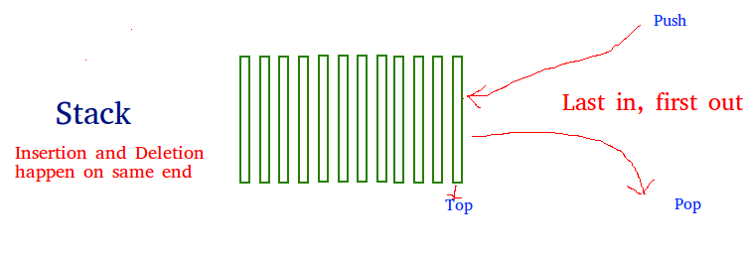
Stacks are a fundamental and linear data structure which follows a particular order in which the operations are performed. The order may be LIFO(Last In First Out) or FILO(First In Last Out).

Slide 3
A user may insert objects into a stack at any time, but may only access or remove the most recently inserted object that remains (at the so-called “top” of the stack).
The stack is a list-like structure in which elements may be inserted or removed from only one end.
While this restriction makes stacks less flexible than lists, it also makes stacks both efficient (for those operations they can do) and easy to implement.

Slide 4
How to understand a stack practically? There are many real life examples of stack.
Consider the simple example of plates stacked over one another in canteen.
The plate which is at the top is the first one to be removed, i.e. the plate which has been placed at the bottommost position remains in the stack for the longest period of time. So, it can be simply seen to follow LIFO/FILO order.
Time Complexities of operations on stack:
push(), pop(), isEmpty() and peek() all take O(1) time. We do not run any loop in any of these operations.

Slide 5
Applications of stack:
Balancing of symbols
Infix to Postfix /Prefix conversion
Redo-undo features at many places like editors, photoshop.
Forward and backward feature in web browsers
Used in many algorithms like Tower of Hanoi, tree traversals, stock span problem, histogram problem.
Other applications can be Backtracking, Knight tour problem, rat in a maze, N queen problem.

Slide 6
Many applications require only the limited form of insert and remove operations that stacks provide.
Accountants used stacks long before the invention of the computer.
The accessible element of the stack is called the top element.
Elements are not said to be inserted, they are pushed onto the stack.
When removed, an element is said to be popped from the stack.

Slide 7
The name “stack” is derived from the metaphor of a stack of plates in a spring-loaded, cafeteria plate dispenser.
Fundamental operations involve the “pushing” and “popping” of plates on the stack.
When we need a new plate from the dispenser, we “pop” the top plate off the stack, and when we add a plate, we “push” it down on the stack to become the new top plate.
An even more amusing example is a PEZ candy dispenser, which stores mint candies in a spring-loaded container that “pops” out the topmost candy in the stack when the top of the dispenser is lifted.
Internet Web browsers store the addresses of recently visited sites on a stack.

Slide 8
Each time a user visits a new site, that site’s address is “pushed” onto the stack of addresses.
The browser then allows the user to “pop” back to previously visited sites using the “back” button.
Text editors usually provide an “undo” mechanism that cancels recent editing operations and reverts to former states of a document.
This undo operation can be accomplished by keeping text changes in a stack.

Slide 9
Implementation:
There are two ways to implement a stack:
Using array
Using linked list

Slide 10
Stack ADT
A stack is an abstract data type (ADT) that supports the following two update methods:
push(): Adds an item in the stack.
If the stack is full, then it is said to be an Overflow condition.
Pop(): Removes an item from the stack.
The items are popped in the reversed order in which they are pushed.
If the stack is empty, then it is said to be an Underflow condition.

Slide 11
Additionally, a stack supports the following accessor methods for convenience:
Peek or topValue( ): Returns the top element of the stack, without removing it (or null if the stack is empty).
length( ): Returns the number of elements in the stack.
isEmpty( ): Returns a Boolean indicating whether the stack is empty.
By convention, we assume that elements added to the stack can have arbitrary type and that a newly created stack is empty.

Slide 12
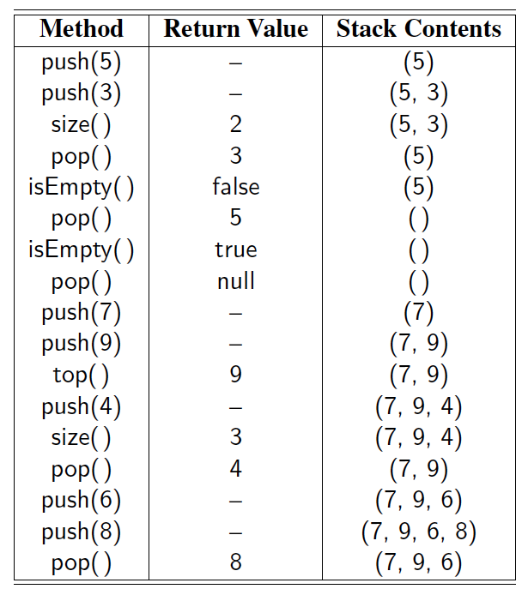
Example

Slide 13
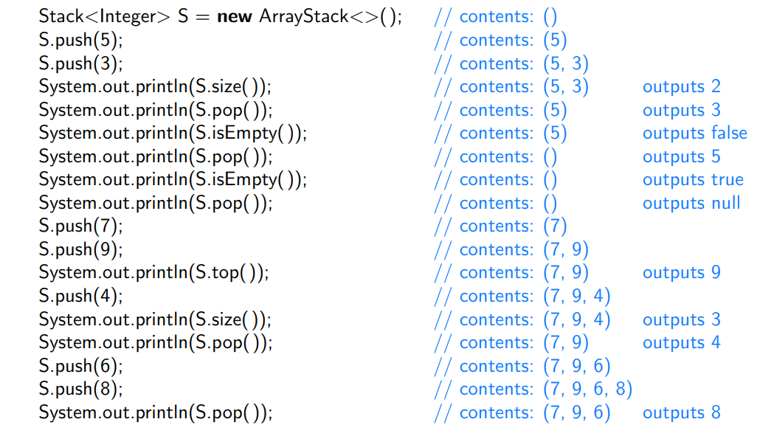
Sample usage of our ArrayStack class.

Slide 14
Array-Based Stacks
The array-based stack implementation is essentially a simplified version of the array-based list.
With the array-based list implementation, listArray must be declared of fixed size when the stack is created.
In the stack constructor, size serves to indicate this size.
Method top acts somewhat like a current position value (because the “current” position is always at the top of the stack), as well as indicating the number of elements currently in the stack.

Slide 15
Linked Stacks
The linked stack implementation is quite simple.
Elements are inserted and removed only from the head of the list.
A header node is not used because no special-case code is required for lists of zero or one elements.
The only data member is top, a pointer to the first (top) link node of the stack.
Method push first modifies the next field of the newly created link node to point to the top of the stack and then sets top to point to the new link node.
Method pop is also quite simple.

Slide 16
Variable temp stores the top nodes’ value, while ltemp links to the top node as it is removed from the stack.
The stack is updated by setting top to point to the next link in the stack.
The old top node is then returned to free store and the element value is returned.

Slide 17
Comparison of Array-Based and Linked Stacks
All operations for the array-based and linked stack implementations take constant time, so from a time efficiency perspective, neither has a significant advantage.
Another basis for comparison is the total space required. The analysis is similar to that done for list implementations.
The array-based stack must declare a fixed-size array initially, and some of that space is wasted whenever the stack is not full.
The linked stack can shrink and grow but requires the overhead of a link field for every element.
When multiple stacks are to be implemented, it is possible to take advantage of the one-way growth of the array-based stack.
This can be done by using a single array to store two stacks.

Slide 18
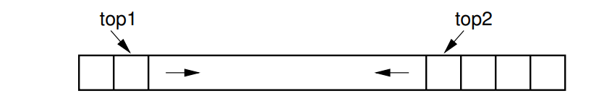
Two Stacks implemented within a single array, both growing towards the middle.

Slide 19
One stack grows inward from each end, leading to less wasted space.
However, this only works well when the space requirements of the two stacks are inversely correlated.
In other words, ideally when one stack grows, the other will shrink.
This is particularly effective when elements are taken from one stack and given to the other.
If instead both stacks grow at the same time, then the free space in the middle of the array will be exhausted quickly.

Slide 20
A test of the reverse method using two arrays.
import java.io.*; class ReverseArray { /* Function to reverse arr[] from start to end*/ static void rvereseArray(int arr[], int start, int end) { int temp; if (start >= end) return; temp = arr[start]; arr[start] = arr[end]; arr[end] = temp; rvereseArray(arr, start+1, end-1); }
/* Utility that prints out an array on a line */ static void printArray(int arr[], int size) { int i; for (i=0; i < size; i++) System.out.print(arr[i] + " "); System.out.println(""); } /*Driver function to check for above functions*/ public static void main (String[] args) { int arr[] = {1, 2, 3, 4, 5, 6}; printArray(arr, 6); rvereseArray(arr, 0, 5); System.out.println("Reversed array is "); printArray(arr, 6); } }

Slide 21
Parentheses Matching (Example & Algorithm)
Each “(”, “{”, or “[” must be paired with a matching “)”, “}”, or “]”
correct: ( )(( )){([( )])}
correct: ((( )(( )){([( )])}))
incorrect: )(( )){([( )])}
incorrect: ({[ ])}
incorrect: (
1) Declare a character stack S. 2) Now traverse the expression string exp. a) If the current character is a starting bracket (‘(‘ or ‘{‘ or ‘[‘) then push it to stack. b) If the current character is a closing bracket (‘)’ or ‘}’ or ‘]’) then pop from stack and if the popped character is the matching starting bracket then fine else parenthesis are not balanced. 3) After complete traversal, if there is some starting bracket left in stack then “not balanced”

